Slide 1
Project 2: Replication Study of (Re-)Imag(in)ing Price Trends
MSBD 5013: Statistic Predicion
By Zhaoyang DENG and Congjian CHEN
May 2nd, 2022

Slide 2
1. Introduction and Task Description
Stock price forecasting from a statistics or machine learning perspective has been a difficult task, because of incomplete data, external economic changes, black swan events, etc.
Currently, many price trend prediction tasks utilize the idea of formulating a model of return prediction based on price trends as a test of the weak-form efficient markets null hypothesis.
In this task, we will be replicate this article “(Re-)Imag(in)ing Price Trends”, which builds on machine learning to reconsider the idea of price-based return predictability from a different philosophical perspective. Specifically, this article turns the stock trend over a certain time period into an image and apply CNN (Convolutional Neural Network) on the image to predict the future trend (up or down).

Slide 3
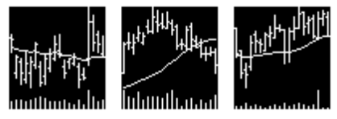
2. Dataset
The daily stock dataset is from CRSP for all firms listed on NYSE, AMEX, and NASDAQ. The sample runs from 1993–2019 based on the fact that daily opening, high, and low prices first become available in June 1992.
The original data has been transformed into images following the same procedures introduced in the paper (Section 2). Current images have the same resolution (64 * 60) and added with moving average lines (MA) and volume bars (VB). Some example figures are shown as follows.
Also, a series of data files in terms of return rates provide labels for our task. We will use Retx_20d_label as our label, which takes value 1 for positive returns for the following 20 days and 0 for non-positive returns.

Slide 4
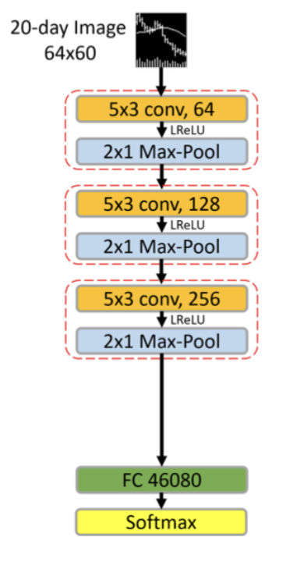
3. Architecture Design
nn.Conv2d(1, 64, kernel_size=(5,3), stride=(3,1), dilation=(2,1), padding=(12,1)),
nn.BatchNorm2d(64),
nn.LeakyReLU(negative_slope=0.01, inplace=True),
nn.MaxPool2d((2,1), stride=(2,1))
Adjust size of channels. The rest is same as layer 1.
nn.Dropout(p=0.5),
nn.Linear(46080, 2)
nn.Softmax(dim=1)

Slide 5
4. Working Flow
Data Split:
A normal economic cycle;
The exclusion of dramatic economic fluctuations favors the forecast.
2018: the rate hike;
2019: the trade war with the start of rate cuts.
Loss and Evaluation:
Cross-entropy loss and accuracy are used.
Train and Test:
Dropout(0.5), Batch normalization and Early stopping(5 epochs)
Train and Validate | Test
2017 (Train:70%, Validate:30%) | 2018,2019

Slide 6
5. Results
Best performance in epoch 17:
Training loss: 0.68;
Validating loss: 0.70;
Test loss: 0.73;
Accuracy: 0.5074

Slide 7
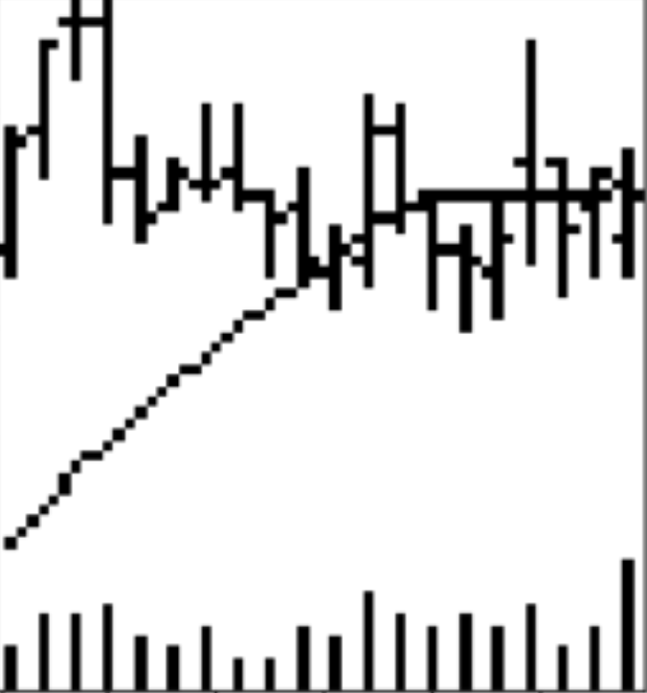
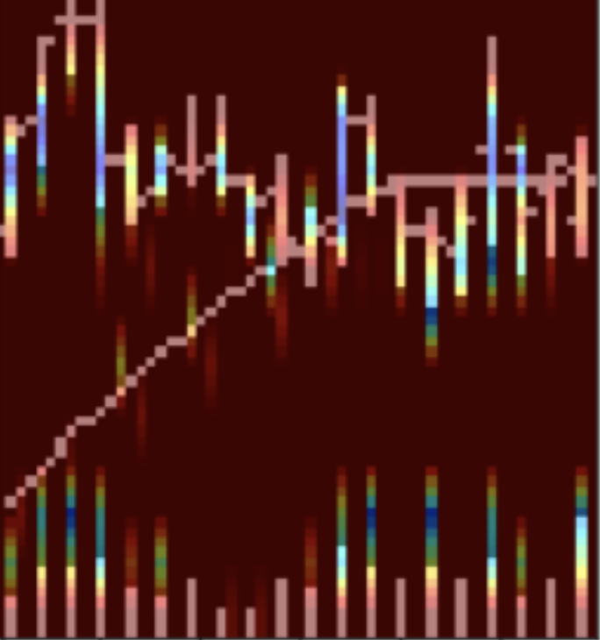
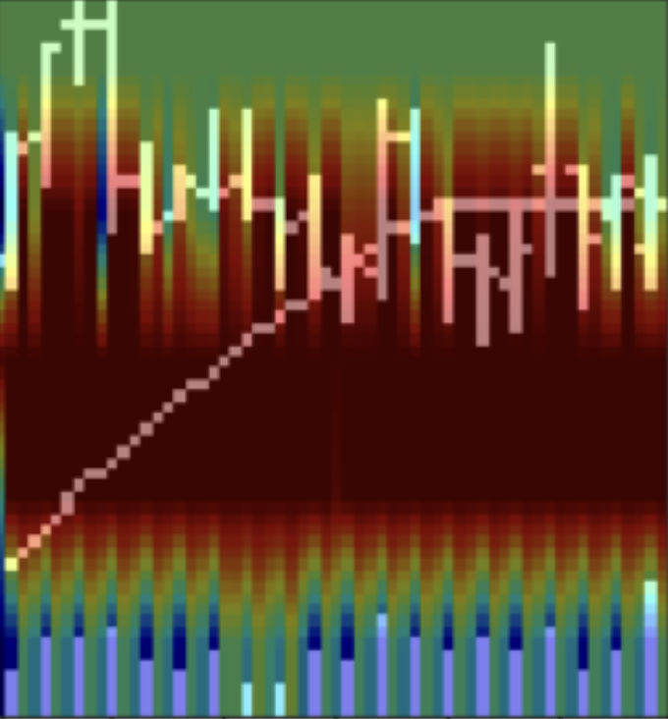
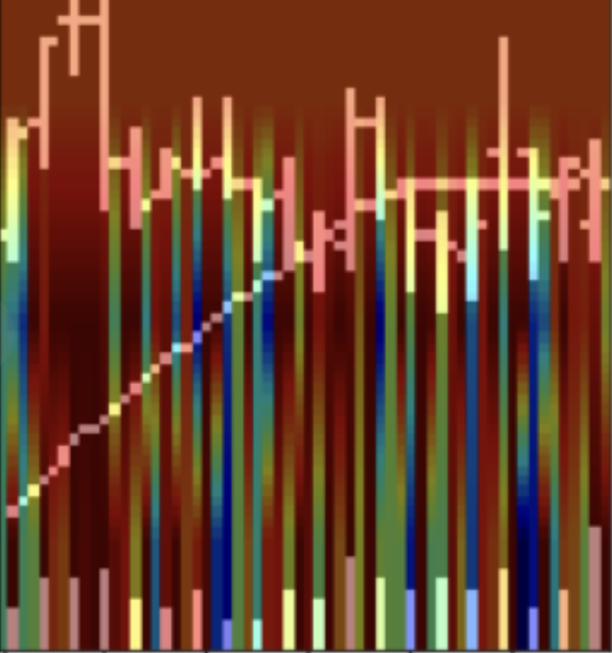
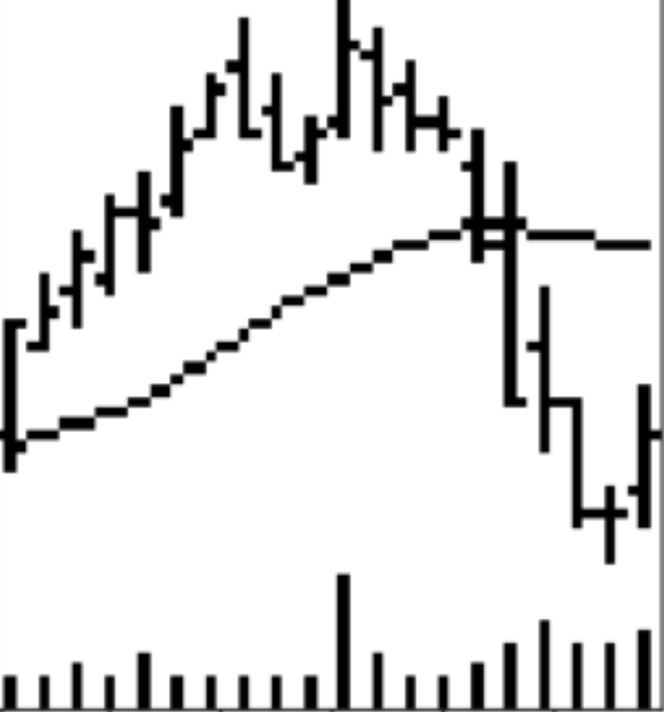
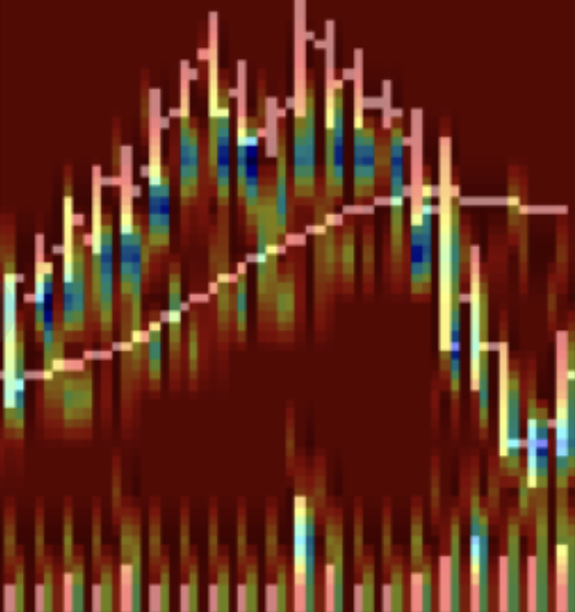
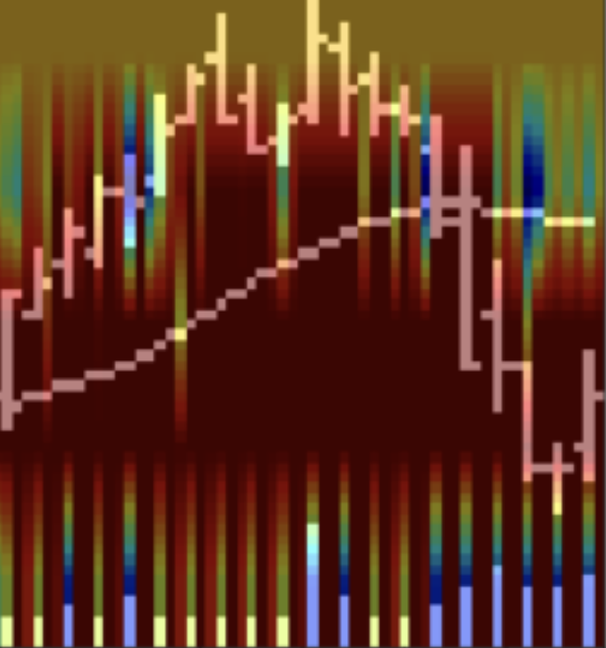
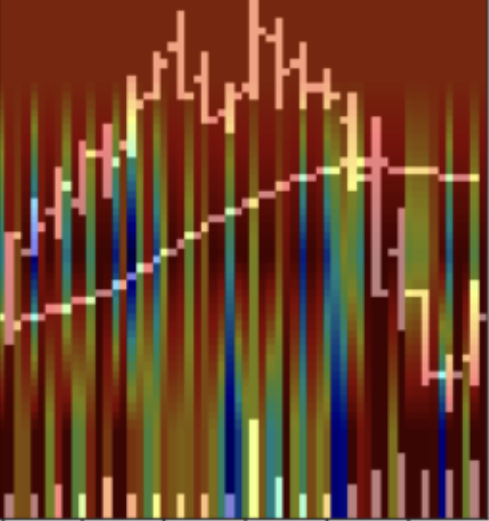
6. Interpretability of the CNN Model by Grad-CAM
The visualization by Grad-CAM helps to explain which part of image the network is pay more attention on in different layers. For a certain region of image, the lighter, the more important.
We randomly select some samples with label=1 and label=0. From the results above, we can see that in layer 1, price bars are brighter. In layer 2, the region above price bars is emphasized. In layer 3, the region between price and volume bars are more activated. The difference between ‘up’ and ‘down’ images is yet not clear.
‘up’
‘down’
Original Image
Layer 1
Layer 2
Layer 3

Slide 8
Thank you for listening!

